Slide 1
Growing Along: CX As Part Of Product Life Cycle
Prob. Statement 1,4

Slide 2
Main Problems
How do we capture User Value as they go from Net Credit User to Net Credit Supplier?
What relevant demographics data can we use to provide lifestyle features to our users?
What up / cross sell opportunities can we take advantage of?
Can we ease the financial burden of budgeting for travel by allowing users to gamify the savings experience?

Slide 3
Creating the User Journey : Benefits
Provide Custom CX to users within a specific demographic instead of a one size fit all conventional CX
Capture vertical specific value from users within a specific age
Show relevant marketing media to relevant users
Deliver user specific sales funnels for various insurance, investment, vehicular, property, and loan / capital acquisition purposes

Slide 4
Creating the User Journey : Good Examples
My AIA SG
Comes with gamified features built in
Lowers costs on insurer in exchange for vouchers
ActiveSG
An ARG with real world perks for their users
Lowers healthcare costs and infrastructural stress by reduced need for healthcare

Slide 5
Creating the User Journey : Bad Examples
Most Banking Apps
Potential for gamification is apparent but not well implemented, especially with availing flexi interest schemes to capture user mindshare
Augments their previous transactional nature, but does not leverage current users to generate more revenue aside from their core activities

Slide 6
Creating the User Journey : User Data Ingest from NDI API
Data gathered within reason: Marriage status and Date Of Birth
Place the User in a predefined timeline as start to CX journey

Slide 7
Creating the User Journey : SMEs
Provide Custom CX to users within a specific demographic instead of a one size fit all conventional CX
Capture vertical specific value from users within a specific age
Show relevant marketing media to relevant users
Deliver user specific sales funnels for various insurance, vehicular, property, and loan / capital acquisition purposes

Slide 8
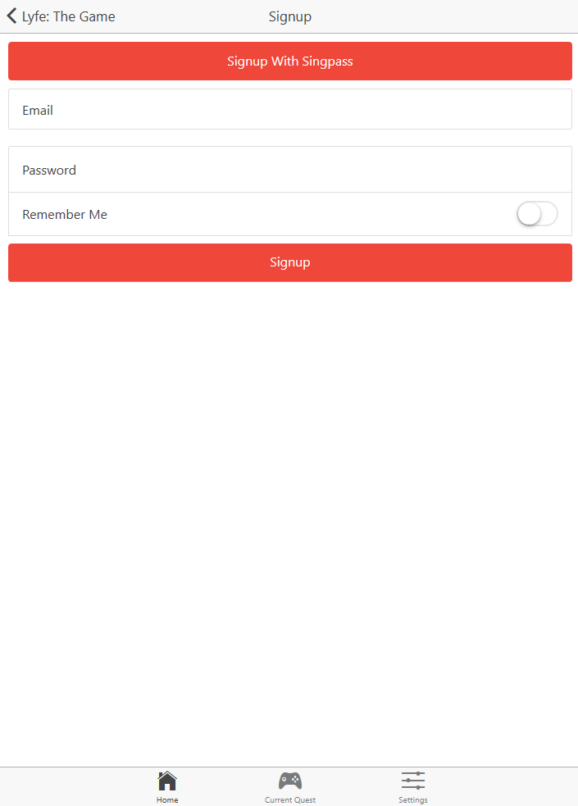
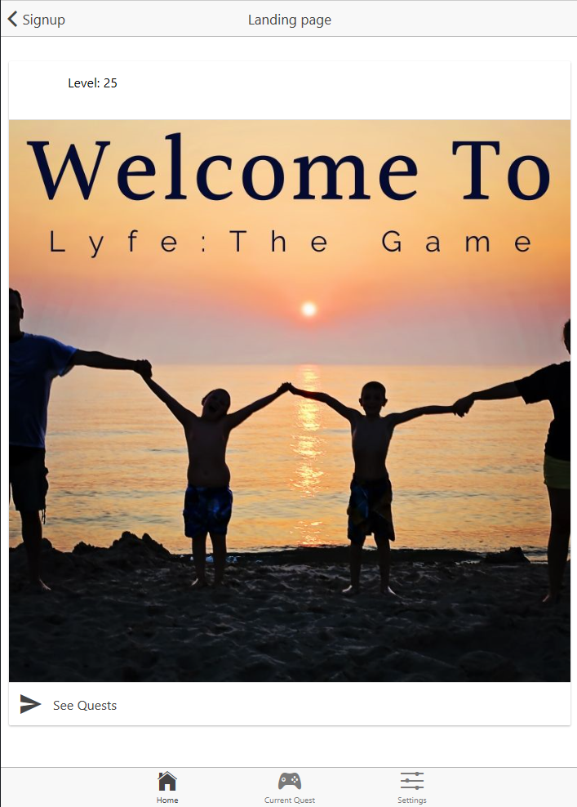
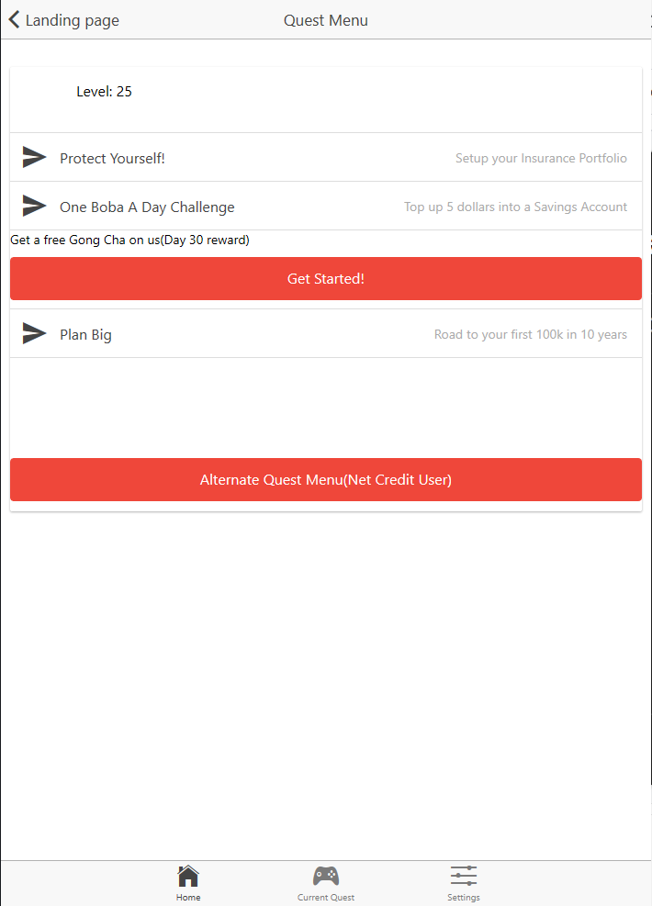
Creating the User Journey : App Interface

Slide 9
Creating the User Journey : Summary
Easy addon to your current UI to leverage on Current Customer base
Minimal cost of implementation
Deliver vertical relevant lifestyle options in a gamified experience(Variety of personal banking products, insurance and investments)
While seamless including it as a customer journey that fully cares for their savings goals and investment goals

Slide 10
Creating the User Journey : End
Thank You!

